Slide 1

Client-Side Programming
Day Three

Slide 2

Welcome Message
Hazard Recognition Course​
Week 1- Summary​
Hazard Recognition Course​
Week 1- Summary​

Slide 3

Review
Review yesterdays materials:
• Working with attributes
• More about Browsers
• Adding Style Attributes
• Understanding Attributes
• Setting up paths and links
• Browser Limitations and alternate content

Slide 4
Web Page Construction and Planning
It is always a good idea to plan out your web pages before building them.
This can help make problems or errors more apparent before doing any actual coding work
Generally you want to sketch a page layout and label it with the sections you intend to include
Another benefit of this is it keeps work organized and can make you more efficient.

Slide 5
Web Page Construction and Planning
It is always a good idea to provide documentation and planning materials with a product, so yourself and others can see what was intended if anything needs to be modified in the future.
Chances are you will not remember a project that you worked on completely, especially if it was 1 month, a year or any longer.
Documentation keeps a project on track and allows others to work with it better.

Slide 6
Sketching an outline
This can begin with pencil and paper.
You generally want to draw the main layout of a page in sections and label the content that will be put into the sections
This rough draft can then be moved into digital format if necessary for refinements.
Many times this job is taken by the graphic designer for the overall look and feel, but can still be used to your advantage, to keep track of your project and keep on task.

Slide 7
Sketching an outline
We will create an outline in MS paint.
Feel free to use any method of drawing to complete the task.
It will help you plan your layouts and document how things will be displayed.
Creating one of these for each page and labeling the special parts for each page is known as “Wireframing”.

Slide 8
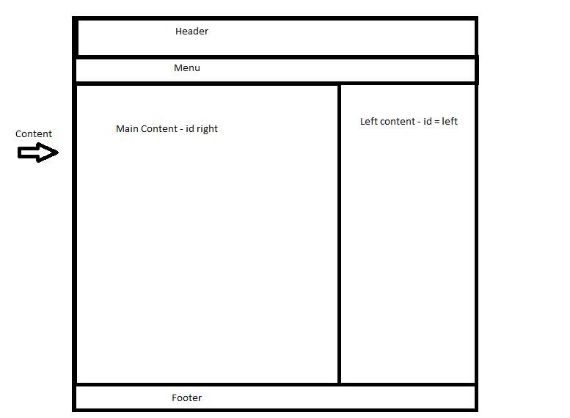
Sketching an outline

Slide 9
Sketching an outline
In the beginning we are looking for a rough outline just to give us something to focus on and write down as a blueprint.
The header is at the top, the menu below that, the content area, which has two smaller content areas, left and right. Left is the main content area. Then there is a footer.

Slide 10
Testing a page
Testing a page requires concentration and attention to detail.
Even for the most seasoned programmers, typos and other mistakes can and will happen.
Testing a page in as many web browsers as possible is ideal, but not always the best for time constraints.
Test in the most recent versions of the main browsers (Chrome, IE, Firefox, Opera, Safari, Mobile Browsers etc) but don’t test each and every version.

Slide 11
Testing a page
Testing a page – Demo creating a wireframe with a graphics editor or on paper.

Slide 12
Adding new elements
Once you are satisfied with your structure, you may want to add other revisions and this might mean adding new elements.
Make sure new elements don’t conflict with other elements (they don’t have the same ID, and don’t push each other out of the way)
Revise your wireframe and account for any major structural changes.
Make sure new elements are properly nested in the correct parent elements.

Slide 13
Nesting elements
Elements can be placed inside other elements, this is referred to as nesting.
We have done this already with the <html></html> tags that surround our code on a page.
<p> <img src=“” alt=“” /> <!-- An image tag nested in a paragraph element -->
</p>
There is no limit to the amount of nested elements you can have on a page.

Slide 14
Nesting elements
Nested elements can also be referred to by their relationship with each other.
This is also known as a parent-child relationship.
Below, the parent is the html tags, the children are the head and body tags.
<html> <head></head>
<body></body> </html>

Slide 15
Using ordered lists
Sometimes we want to group elements or lists on a page.
We can use ordered lists to provide this structure for us.
Ordered lists are numbered lists of list items
i.e. – 1. Milk
2. Bread
3. Eggs

Slide 16
Using ordered lists
We can use an ordered list
This provides numbers for the content

Slide 17
Using ordered lists
Ordered List Demo
Orderlists.html

Slide 18
Understanding Domains and HTTP
Domains are like a naming system for web servers.
Normally computers over the internet identify each other by IP addresses. 16.120.10.1 is an example.
These are hard to remember for humans so a descriptive naming system had to be developed.
It works like a phone book when you look for www.abcbusiness.com your internet provider looks up in its list the internet address where the server and website is located.
Once that connection is made, the client (the web browser) and the server (the web host) can talk to each other.

Slide 19
Understanding Domains and HTTP
The type of document normally sent over http is an html, hypertext markup language.
Since we are sending hypertext, HTTP is the hypertext transport protocol.
It runs normally on port 80. FTP is usually on port 21.
There is also Secure HTTP for encrypted communication.
This will appear as https://

Slide 20
Hosting companies
There are many hosting companies out there, some free, some paid.
Hosting is an expensive business and if you want maximum uptime for your site, then you need something that is reliable.
Generally, paid hosts will provide better service, more uptime, more features.
Many hosting companies provide 99% uptime guarantees.

Slide 21
Hosting companies
Some examples are bluehost.com, godaddy.com, name.com.
Many hosting companies offer services to buy your domains directly with them along with your hosting package.
For most web developers, it is good to go with a Linux based package that includes PHP and mySQL, as well as cPanel.

Slide 22
Hosting companies
PHP and MySQL will be used later in the course.
They are the lowest cost and easiest to maintain.
cPanel is a user-friendly menu interface for accessing the common features on a web host.
Be wary of some hosts that don’t offer cPanel as they may not have user friendly ways of accessing some of their features.

Slide 23
Domain fundamentals
A domain name is our way of connecting internet addresses (IP addresses) to www.abcbusiness.com.

Slide 24
Using FTP
FTP stands for File Transfer Protocol.
We can use FTP to upload our sites to our online folders.
We use an FTP client, such as FileZilla, to connect to our web host, and upload or download files.
This will make those files visible on the internet.

Slide 25
Using FTP
When we sign up for a host, we are provided with an ftp address, username and password for accessing the location where you will store your files.
The ftp address is usually your domain name dot ftp dot domain type.
For example, ftp.abcbusiness.com

Slide 26
Using FTP
You can also use the IP address for direct access.
Sometimes a domain is in the process of being transferred, or being pointed to, and is not ready to be accessed by the domain name yet. This will require the use of an IP address to access the FTP until the domain is properly linked to the site.
Transferring a domain or changing its nameservers (nameservers point the domain name to the right server) can take 24-48 hours, so in this time frame using an IP address would be necessary as well.

Slide 27
Dissecting URLs
URLs tell us about the resource we are connecting to online.
Take http://www.abcbusiness.com/index.html
There are five parts you can break this down into.

Slide 28
Dissecting URLs
http://www.abcbusiness.com/index.html
Protocol – http:// Hypertext transport protocol. (A protocol is a set of rules for doing something. The protocol for speaking with another person is the language you use.)
www – world wide web address
abcbusiness – the domain name of the site.
.com – the type of domain. In this case commerce.
/index.html – the specific file or resource we want to access. In this case, the index page.

Slide 29
Dissecting URLs
ftp.abcbusiness.com
This url is for our file transfer protocol ftp.
abcbusiness is the domain name.
.com is the type of domain
www.abcbusiness.com/images/
Images/ is a folder path, so it will bring you to a page where you can select what you want from a directory. You wil be denied access if you don’t have permissions to access the directory.

Slide 30
Absolute Paths
As mentioned previously, Absolute Paths provide the entire path to a file or resource.
For example http://www.abcbusiness.com/index.html
Absolute paths can be contrasted with Relative Paths which are a partial path, but useful for resources that are hosted on the same server.

Slide 31
Absolute Paths
Relative paths prevent the programmer from having to retype the entire path each time.
For example “img/image1.jpg” takes the current file’s location into account as wwwroot/index.html.
In the same folder is a folder called “img” that holds all the images.
image1.jpg is in the img folder.

Slide 32
Absolute Paths
Absolute paths are good for when you have to access resources on another web site – like a link to another site.
Relative paths are good for when you have to access resources on the same site, so when you want to display images from the images folder, or you want to link to a style sheet.

Slide 33
Absolute Paths
Demo Absolute and Relative links
Absoluteandrelativelinks.html

Slide 34
HTTP Protocol Fundamentals
HTTP stands for HyperText Transport Protocol
It is the default communication protocol for web sites.
By using a common set of rules and procedures (a protocol), computers on the internet are able to communicate and share information.

Slide 35
HTTP Protocol Fundamentals
HTTP Status Codes are used when the client (web browser) requests a resource.
The status codes indicate the success or failure in receiving the resource.
Common status codes include:
200 – OK – the resource was found
404 – Not Found – the resource was not found on the server.
500 – Internal Service Error – there was a problem on the server.

Slide 36
HTTP Protocol Fundamentals
Codes are classified as follows:
1xx codes - Informational
2xx codes – Client Success
3xx codes – Redirection
4xx codes – Client Error
5xx codes – Server Error

Slide 37
HTTP Protocol Fundamentals
It is not expected for beginners to memorize the list of codes, but having a good idea of the most common ones is essential.
When a developer is aware of these codes they can handle them gracefully – meaning the user doesn’t always have to see an ugly error page.
If your application is set up to handle errors you can customize a page to maintain the look and feel of a site when an error does occur.

